Slide 1

Lambda calculus —Origin, Introduction and Application

Slide 2
What’s lambda calculus?
It’s a model of computation.
Theory of computation
——Studies “What are the fundamental capabilities and limitations of computers?”
In order to perform a rigorous study of computation, computer scientists work with a mathematical abstraction of computers called a model of computation.

Slide 3
Origin
Georg Cantor —— Set theory（1874）
Naïve 🐸
Bertrand Russell —— Barber paradox（1901）
Crisis of mathematics —— Solved by Axiomatic system
David Hilbert's program
Kurt Gödel's incompleteness theorems
Church–Turing thesis
Notes:
集合论出现后，几乎渗透了一切领域，“一切数学成果可建立在集合论基础上”
然而是Naïve的把集合作为叫做这个集合的“元素”或 “成员”的搜集（collection）。
悖论：承认它是真的，经过一系列正确的推理，却又得出它是假的；如果承认它是假的，经过一系列正确的推理，却又得出它是真的。
罗素悖论， P(x) = x ∉ x（包含自己的集合很难想象，只是理论上不排除它的存在而已，朴素集合论是允许的（存在集合S，它刚好包含所有具备性质P(x)的对象，而且只包含具备性质P(x)的对象））
S={x|P(x)}。 罗素问：S∈S ?
若 S∈S, 则 P(S) = False，所以S∉S。若S∉S，则P(S) = True, S∈S
S∈S⇔S∉S=¬(S∈S)
冯诺依曼提出，全体集合构成的集合，不能是集合论的一个对象、元素。罗素悖论就是因为把全体集合构成的东西当做集合（集合论语言中的元素）来处理。冯诺依曼提出，全体集合构成的东西可以作为类提起，但不能作为集合参与集合论的运算

Slide 4
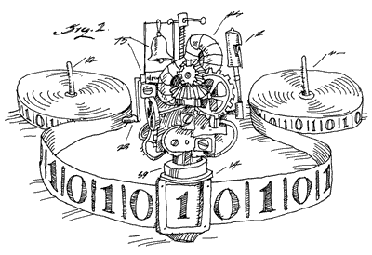
Turing machine
Simulation and Abstraction of mankind calculus
Read or Write some symbol
Divert attention from one place to another
So we need
A tape, Infinite length
A head, To read or write
A register, Storing current state
A table, T(Current, Input)
->T(Next, Output, {L/R})
Including Accept and Reject
A set of input characters

Slide 5
A Simple Imperative Programming
move <direction>
– Moves the tape head the specified direction (either left or right)
write <symbol>
– Writes symbol s to the tape.
goto <N>
– Jumps to instruction number N (all instructions are numbered)
If < symbol>, goto <N2>
– If the current tape symbol is s, jump to the instruction numbered N.
Accept and Reject
– Ends the program.

Slide 6
Halting Problem
//Turing Machine “God(P)”
Start: If ((P, D) accept), goto 3
2 : reject
3 : accept
//Turing Machine “Satan(P)”
Start: if(God(P, P) accept), goto 3
2 : accept
3 : goto 3
//Now we run Satan(Satan)
If(God(Satan, Satan) accept), goto 3

Slide 7
But it’s not that concise, that pretty in math
Turing Machine | A 7-tuple: M = <Q, Γ, b, Σ, δ, q0, F>
Q | Q is a finite, non-empty set of states
Γ | Γ is a finite, non-empty set of the tape alphabet/symbols
b or # | b ∈ Γ is the blank symbol
Σ | Σ ⊆ Γ - {b} is the set of input symbols
q0 | q0 ∈ Q is the initial state
F, accept | F ⊆ Q is the set of final (accepting) states
δ | δ: Q - F × Γ → Q - F × Γ × {L, R} is a partial function called the transition function, where L is left shift, R is right shift.
reject | Equivalent to Q - F (not part of the 7-tuple)

Slide 8
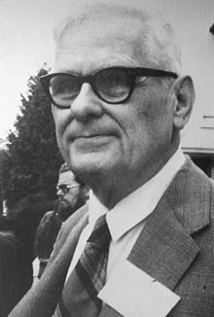
Alonzo Church (1903–1995)
Introduced the lambda calculus in the 1930s. Proved logically inconsistent in 1935 when Kleene–Rosser paradox was developed.
The portion relevant to computation, called the untyped lambda calculus was published in 1936.
A computationally weaker, but logically consistent system, simply typed lambda calculus was published in 1940.

Slide 9
Very Concise Form
What is primitive in Lambda Calculus?
——Merely anonymous functions
Expression | Semantics
<identifier> | Identifier reference
λ <identifier-list>. <expr> | Function Definitions
(<expr> <expr>) | Function application

Slide 10
Examples of Lambda Expressions
Just an identity
x
The identity function:
λx. x
A function that given an argument y discards it and returns the identity function:
λy. (λx. x)
A function that given a function f invokes it on the identity function
λf. f (λ x. x)

Slide 11
Left associative
Frequently the parentheses are left off when it will not cause confusion.
In these cases, remember:
Application is left associative:
a b c = ((a b) c)
There is only one lambda expression in the body of an abstraction.
(λx.x y)

Slide 12
Bound and Free Variables
A bound variable is a variable that is in the scope of a declaration (lambda binding) for that variable. A variable that is not bound is free. In the expression:
λx. (λy. x z)
x is bound and z is free (the y-binding has no effect as there is no y in the body of the expression)

Slide 13
Alpha Reduction
Convention: we will always rename bound variables so that they are all unique
e.g., λ x. x (λ x.x) x can be reduced to λ x. x (λ y.y) x, writes alpha[x / y]
This doesn't change the meaning of the expression.

Slide 14
Beta Reduction
The substitution of e for x in E (λx.E e => E[x := e] )
Step 1. Rename bound variables in E and e so they are unique
Step 2. Perform the textual substitution of e for x in E
Example: (λx. x)t= t
Example: (λy. (λx. x) y x) (y (λx. x))
After renaming: (λz. (λu. u) z x) (w (λv. v))
After substitution: (λu. u) (w (λv. v)) x
((λu. u) (w (λv. v))) x
(w (λv. v)) x
Notes:
The definition of substituition that requires minimal renaming is quite complicated.
Historically, a number of mistakes have been made while formalizing it.
The approach taken here simplifies its definition considerably.

Slide 15
Eta Reduction
An eta conversion is adding or dropping of definition over a function.
λx. f x => f Where x must be bind variable
Example: (λy.λx.yx)(λy.λx.yx) is equal to (λy.y)
Notes:
The definition of substituition that requires minimal renaming is quite complicated.
Historically, a number of mistakes have been made while formalizing it.
The approach taken here simplifies its definition considerably.

Slide 16
Currying
Functions in lambda calculus only receives one parameter
——What about Multivariate functions?
f(x, y) = x + y //Here I will use some yet undefined expressions “plus”, “2”, “3”
λ x. (λ y. plus x y ) //ATTENTION：The function body is itself function ！！！
Have a try : λ x. (λy. plus x y) 2 3 = (λy. plus 2 y) 3 = plus 2 3 = 5
We can write λ x y. plus x y for short

Slide 17
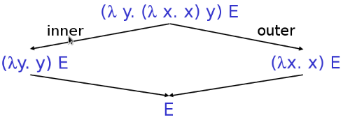
Evaluation Order
Consider this function application
(λ y. (λ x. x) y) E
We can first apply y to (λ x. x), and we can also first apply E to (λ y. (λ x. x) y)

Slide 18
Evaluation Order
The first strategy is called Applicative order.
evaluate all arguments, then apply operator
The second strategy is called Normal (Lazy) order.
pass unevaluated expression to function
evaluate only when needed for primitive operation
Proved by Church–Rosser theorem, the ordering in which the reductions are chosen does not make a difference to the eventual result.
But……In some ways, program will stuck in infinite calculating if using applicative order

Slide 19
We want more…
Number and algebra
If statement
Recursive(Loop can be implemented by Tail Recursion)
Data Structure

Slide 20
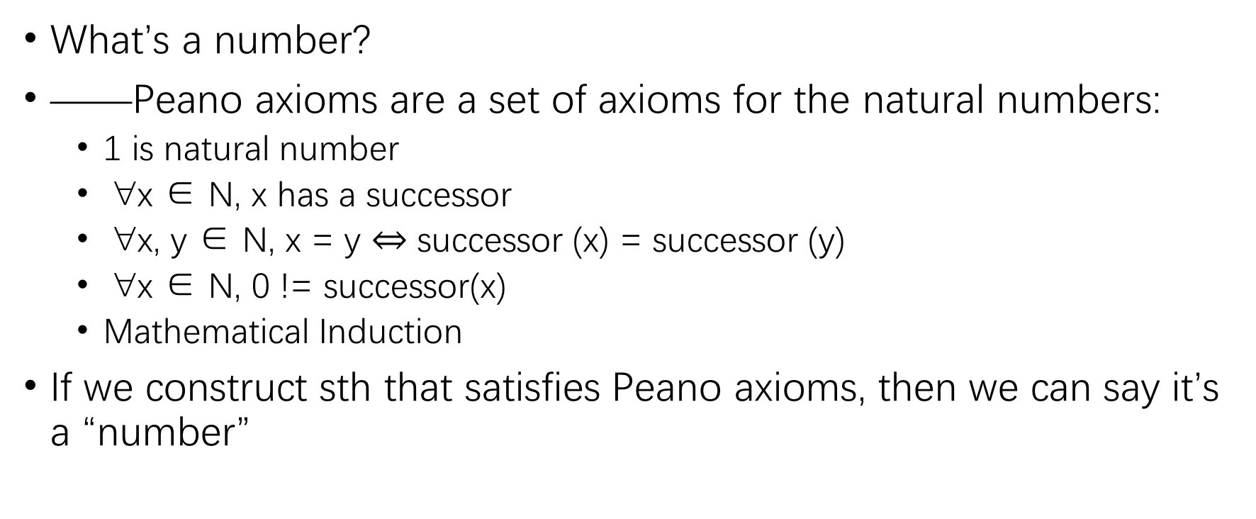
Number
What’s a number?
——Peano axioms are a set of axioms for the natural numbers:
1 is natural number
∀x ∈ N, x has a successor
∀x, y ∈ N, x = y $⇔$ successor (x) = successor (y)
∀x ∈ N, 0 != successor(x)
Mathematical Induction
If we construct sth that satisfies Peano axioms, then we can say it’s a “number”

Slide 21
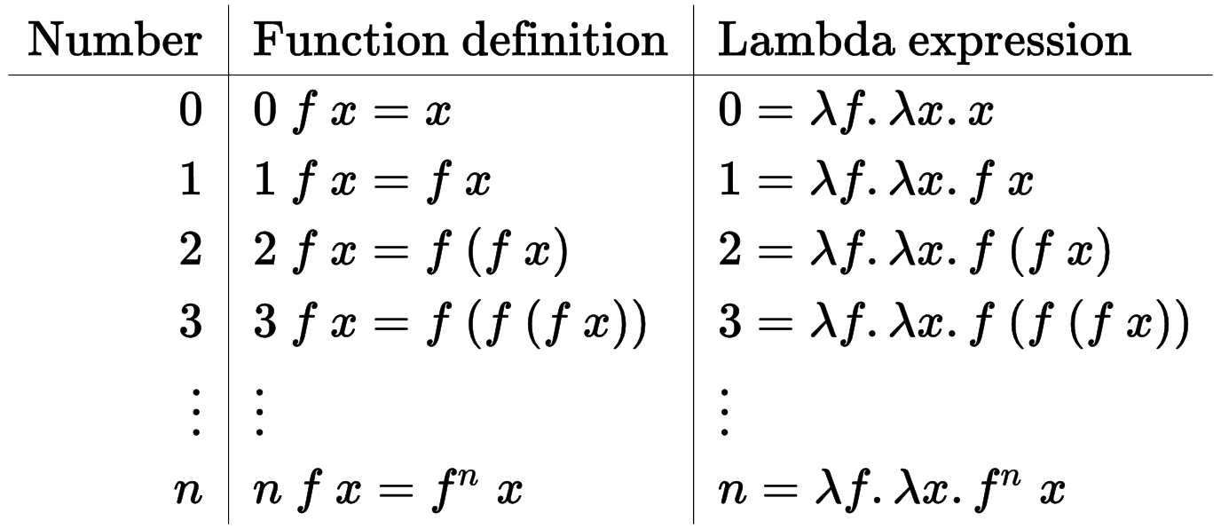
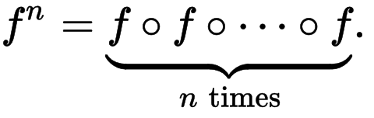
Church encoding

Slide 22
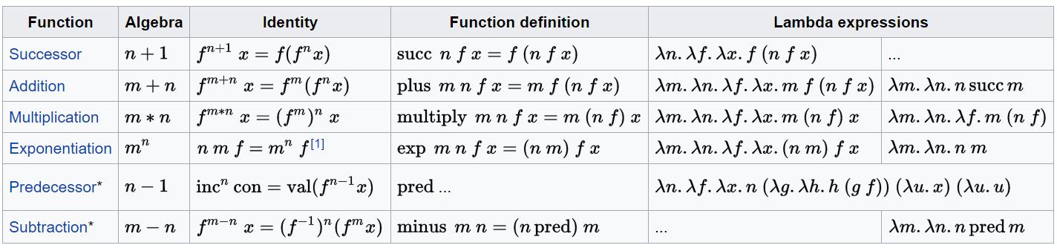
Church encoding

Slide 23
Bool encoding
Boolean logic may be considered as a choice. The Church encoding of true and false are functions of two parameters;
true chooses the first parameter.
false chooses the second parameter.
true = λ x y. x
false = λ x y. y
xor = λ a b. a ( b F T ) b
xor T T = T (T F T) T = T F T = F
xor F F = F (F F T) F = F T F = F
xor T F = T (F F T) F = T T F = T
xor F T = F (T F T) T = F F T = T

Slide 24
If Statement
We can simply implement if Statement:
<predicate> then-statement else-statement
<predicate> is a function that returns an true or false

Slide 25
If Statement
We can simply implement if Statement:
<predicate> then-statement else-statement
<predicate> is a function that returns an true or false

Slide 26

Recursion

Slide 27
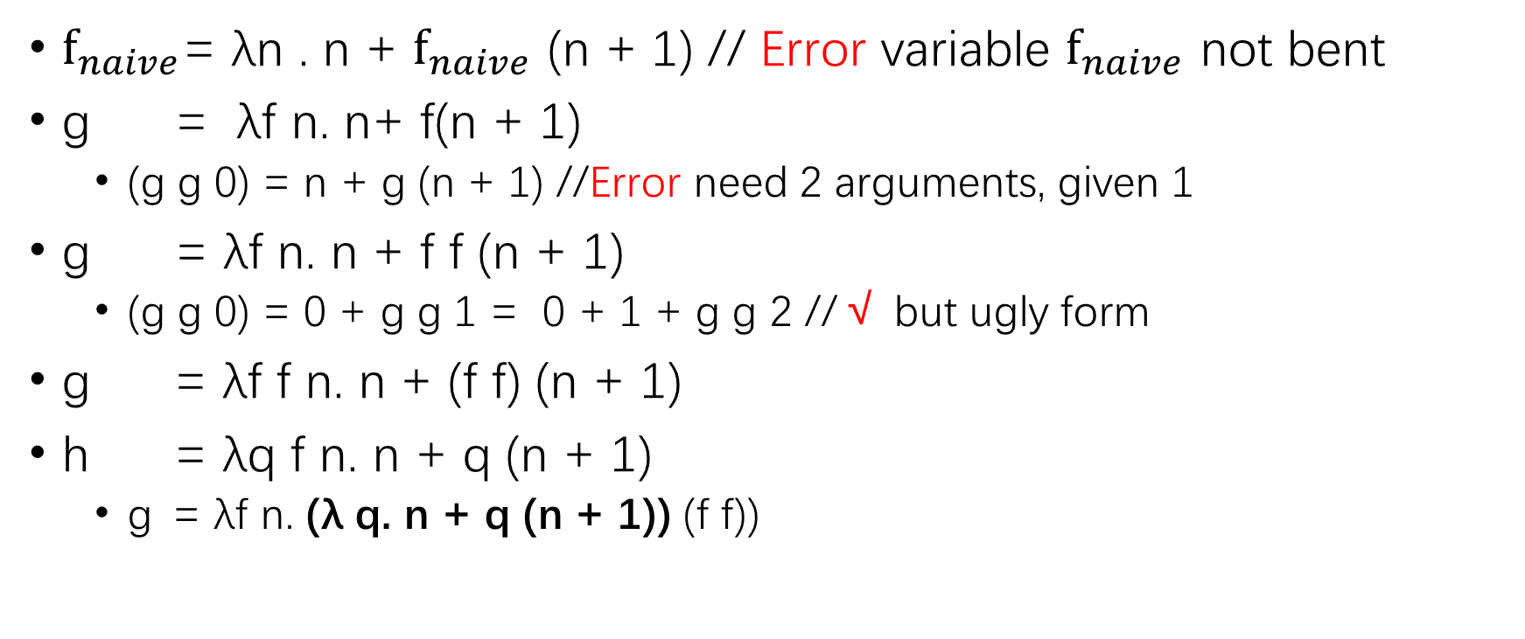
A function returning 1 + 2 + ··· + …
$f_{naive}$= λn . n + $f_{naive}$ (n + 1) // Error variable $f_{naive}$ not bent
g = λf n. n+ f(n + 1)
(g g 0) = n + g (n + 1) //Error need 2 arguments, given 1
g = λf n. n + f f (n + 1)
(g g 0) = 0 + g g 1 = 0 + 1 + g g 2 //√ but ugly form
g = λf f n. n + (f f) (n + 1)
h = λq f n. n + q (n + 1)
g = λf n. (λ q. n + q (n + 1)) (f f))

Slide 28
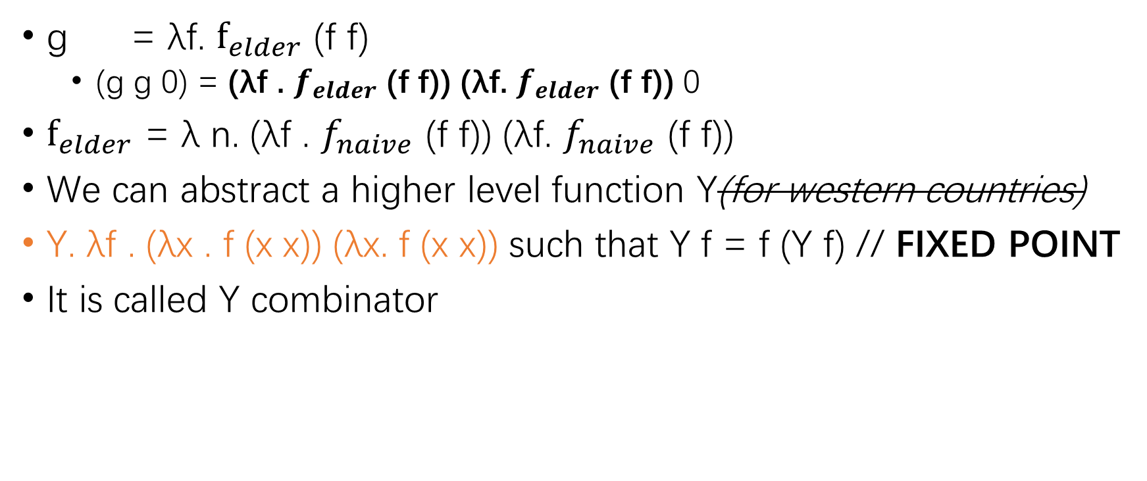
Y combinator
g = λf. $f_{elder}$ (f f)
(g g 0) = (λf . $f_{elder}$ (f f)) (λf. $f_{elder}$ (f f)) 0
$f_{elder}$ = λ n. (λf . $f_{naive}$ (f f)) (λf. $f_{naive}$ (f f))
We can abstract a higher level function Y(for western countries)
Y. λf . (λx . f (x x)) (λx. f (x x)) such that Y f = f (Y f) // FIXED POINT
It is called Y combinator

Slide 29
Practice
In languages that use applicative order (like scheme) , this implement will cause infinite loop(f ( f (f (f (f Y)))))
So we had to use a thunk …
(x x) => (λ y. (x x) y) (eta-reduction)
And things in normal order languages (like Haskell) don’t seem better…If you see some any good one, tell me please ☺

Slide 30
Data Structure — Pair
What is MENT by a pair? // P = (x, y) ?
It provides two method, called car, cdr, returning two objects
car = (λP.<body1>) P = x
cdr = (λP.<body2>) P = y
And P is constructed by cons ( its return value )
cons = (λ x y. <body3>)

Slide 31
Pair — implement
cons = λx y.λp. p x y //p for <predicate>
car = λ P.P true // P for pair
cdr = λ P.P false
Have a try…
car (cons 1 2) = (λP. P true) ((λx y. λp . p x y) 1 2)
= (λP. P true) (λp . p 1 2)
= (λp. p 1 2) true
= 1

Slide 32
Pair — implement 2
It that the only implement?
No, as Wallace says👱: If an object walks like a duck and talks like a duck, then it must be a duck!
A tricky implement, a b -> 2^a * 3^b
//72=2^3*3^2=2*2*2*3*3
cons = λ x y. 2^a * 3^b
car = λ z. ((z % 2) == 0) ((car (z / 2)) + 1) 0
cdr = λ z. ((z % 3) == 0) ((car (z / 3)) + 1) 0

Slide 33
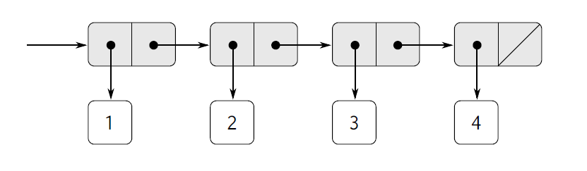
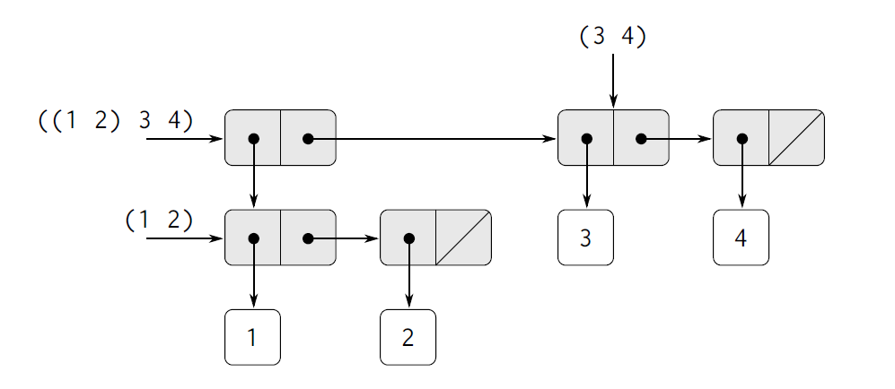
List, tree
Lambda expression has Closure Property
List: a chain of pairs
Tree: combination of lists

Slide 34
Lambda Calculus and Type
Till now, we just talk about simply non-type LC
Now we talk about simple typed LC

Slide 35
Simple Typed LC
Base type
eg : N for natural numbers, S for string, B for bool
Function type
function type constructor ->
A -> B means a function receive argument typed A, return type B
-> is right associative, a -> b -> c = a -> ( b -> c)
Syntax extension
E : T means expression E has type T

Slide 36

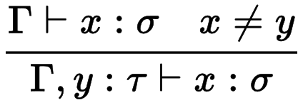
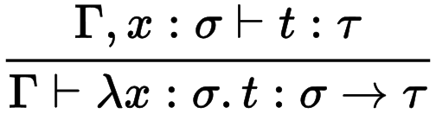
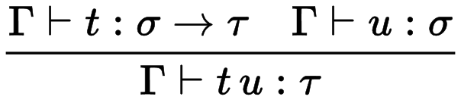
Type Inference Rule
1.
2.
3.
4.
1.if x has type σ, then we can know x has type σ
2.In context that x has type σ, x != y, we can inferin this context, if y has type τ, we can know x has type σ
That is, introduction of y doesn’t change type of x
3. In context that x has type σ, y has type τ,
function λx. y has type σ -> τ
4. In context that we have function t typed σ -> τ, u has type σ, function application t u has type τ

Slide 37
Have a try
λx y . y x has undecided type, x : A, y : A -> B
λx y . y x : A -> (A ->B) -> B
When we apply 3, (λ a : N . (* a a)) to it
(λ x y . y x) 3 (λ a : N . (* a a))
(* a a) has type N (Rule 4)
(λ a. (* a a)) has type N -> N (Rule 3)
x has type N, y has type N -> N, so y x has type: N
(λ x y. y x) has type N -> (N -> N) ->N

Slide 38
What I didn’t mension
Combinatory logic
Curry–Howard correspondence
System F
Lambda cube

Slide 39
LC and FP —— LISP(McCarthy 1960)
LISP: used LAMBDA to present function, looks like it
((ONE.(TWO.(THREE.NIL)))
With addition primitive funcitons, cons, car, cdr,eval,quote……
But, in fact it’s based on Kleene’s recursive theory
Cannot return a function
Error binding free variables when passing function as argument
LISP is never pure

Slide 40
LC and FP —— Algol 60 (Naur 1963)
Is not usually considered a FP
Support nested procedures and passing procedures as argument
Using two sets of links between stack frames
Cannot return a function

Slide 41
ISWIM (Landin 1966)
Sugared LC + assignment + control
let, rec, and ,where
let g b c = f(b+2c) + f(2b-c)
where f(x) = x(x+a)
and a = 1
mutable variable, =
Able to return a function using closure

Slide 42
PAL(Evans 1968)
Inspired by ISWIM
applictive PAL: sugared λ + conditional expr
imperative PAL: add mutable, assign, first class labels
Support pattern matching

Slide 43
SASL(Turner 1972)
Inspired by PAL
Support Multi-Level pattern matching
x = ((1,2), (3,4)) , now we want ((3,4), (1,2))
LISP
cons(cons(car(car(cdr(x))), cons(car(cdr(car(cdr(x)))), nil)), cons(cons(car(car(x)),cons(car(cdr(car(x))), nil)), nil))
SASL
let ((a,b), (c,d)) = x in ((c,d), (a, b))
Support lazy evaluation since SALS 1974-84

Slide 44
Burstall (1969)
Support case expression
case lst of
[] => …
| x:xs => …

Slide 45
ML
Hindley–Milner type system
Static typed, type infer, implicit typed
val times = (fn x => (fn y => x * y));
compile will auto infor its type:
val times = fn : int -> int -> int
Type variable, polymorphically typed
fun deal_pair f (a,b) = f a b;
val deal_pair = fn : ('a -> 'b -> 'c) -> 'a * 'b -> 'c

Slide 46
Haskell
Type classes, monad, a module system with two level names
http://jiyinyiyong.github.io/monads-in-pictures/

Slide 47

Thanks for listening

